Slide 1
Drug Mortality and Socio-Economic conditions in Connecticut
Sandhya Govindaraju, Monica James, Yayun (Aaron) Liu, Alisha Pandhi

Slide 2
Project Description
We were looking to analyze trends in drug overdose death rates in Connecticut by:
Income
Age
Education
Gender
Geo-location (counties)
Unemployment rates
Barriers to medical treatment
Drug

Slide 3
Data Sources
Accidental Drug Overdose Related Deaths in Connecticut 2012-2017.csv. (source:Data.gov)
2016 Education Attainment Connecticut.csv (source: census.gov)
2016 Employment Status by Age.csv (source: census.gov)
2016 Median Household Income County.csv (source: census.gov)
FairfieldCountyPopulation.csv (source: census.gov)
HartfordCountyPopulation.csv (source: census.gov)
LitchfieldCountyPopulation.csv (source: census.gov)
MiddlesexCountyPopulation.csv (source: census.gov)
NewHavenCountyPopulation.csv (source: census.gov)
NewLondonCountyPopulation.csv (source: census.gov)
TollandCountyPopulation.csv (source: census.gov)
WindhamCountyPopulation.csv (source: census.gov)
DEC_10_DP_DPDP1_with_ann.csv (source: census.gov)
PopByCountyByYear.csv (source: factfinder.census.gov)
tl_2010_09_county10.json (source: factfinder.census.gov)
Unemployment Rate by County.csv (source: BLS Public Data API)

Slide 4
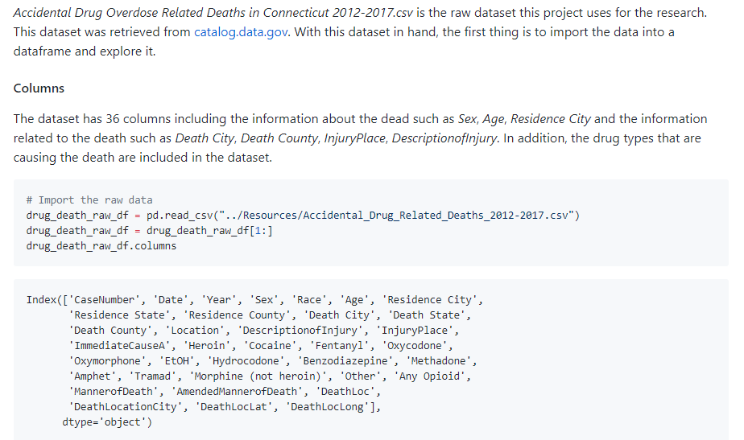
Data Cleanup & Analysis

Slide 5
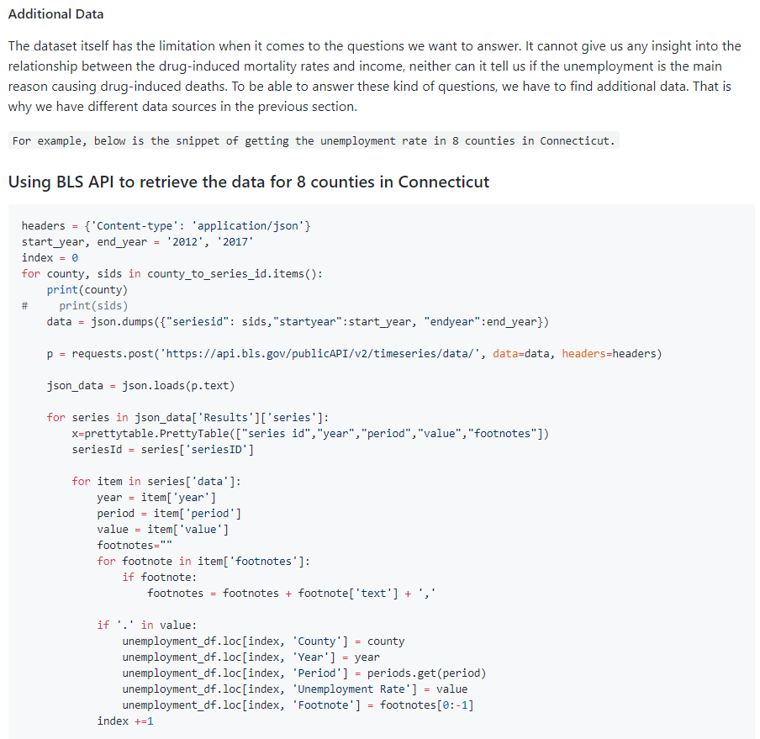
Additional Data

Slide 6
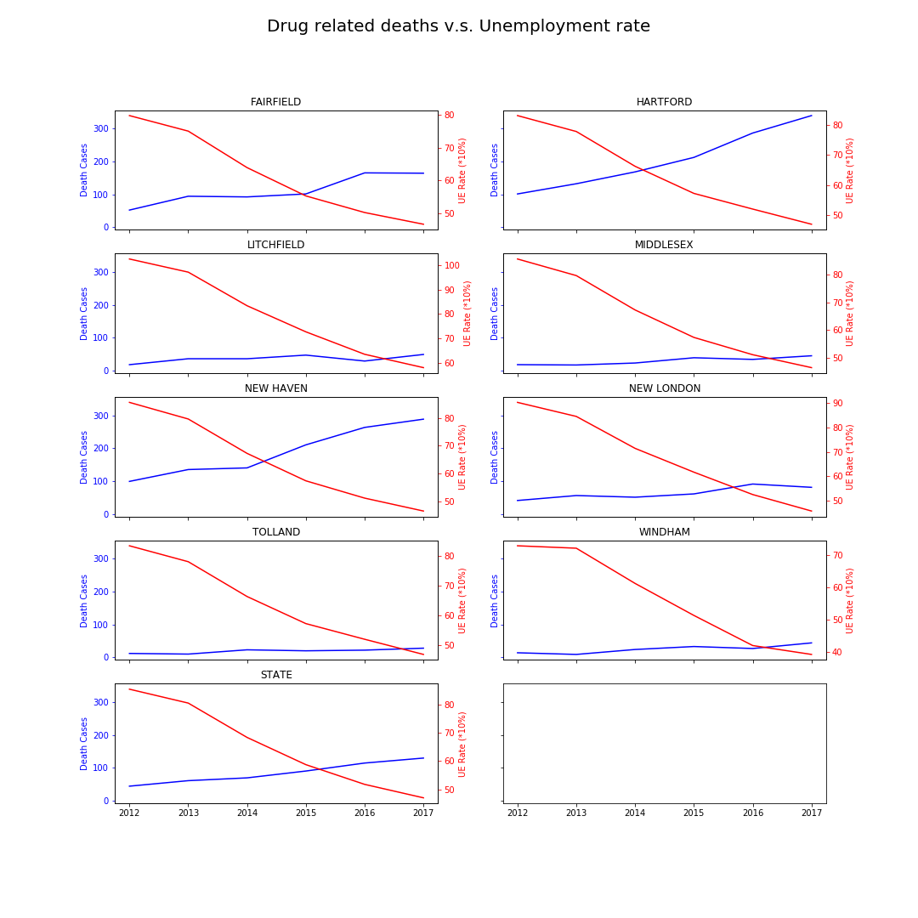
Drug-induced Mortality and Unemployment rates

Slide 7
Struggles with data
We were not able to find reliable data to analyze and plot these trends:
Drug-induced mortality rates and income
Drug-induced mortality rates and education

Slide 8
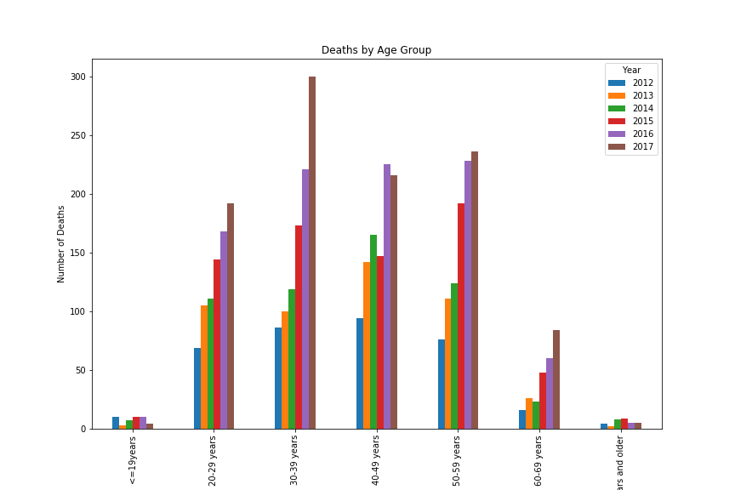
Drug-Induced Mortality and Age

Slide 9
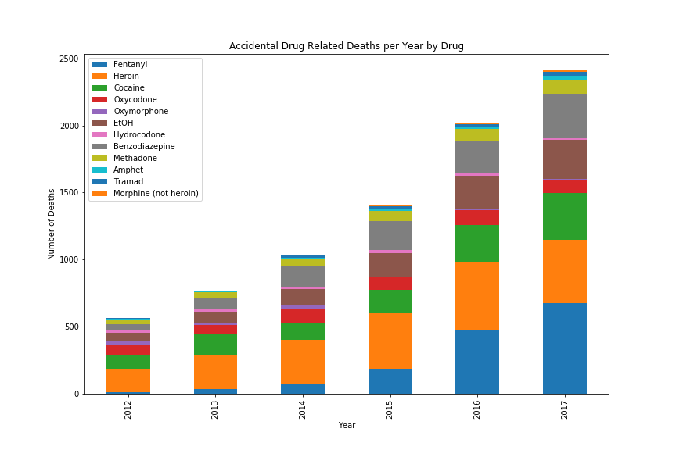
Drug-Induced Mortality by Drug

Slide 10
Fentanyl
Fentanyl is a synthetic opioid similar to heroin, gives the user feelings of euphoria and sedation
30-50 times more potent than heroin
50-100 times more potent than morphine
Because of its potency, it provides a high profit margin for drug traffickers
It is usually combined with other drugs, so it can vary in potency, in some cases leading to an overdose.
Naloxone is effective against Fentynal, however since it is more powerful than heroin, it may take more than one dose
Street names are: Apache, China Girl, China Town, Dance Fever, Friend, Goodfellas, Great Bear, He-Man, Jackpot, King Ivory, Murder 8, and Tango & Cash

Slide 11
Drug-induced mortality rates and barriers to medical treatment
Opioid abuse/misuse is at unprecedented levels.
Naloxone (Narcan) is the antidote to an opioid overdose.
AN ACT CONCERNING SUBSTANCE ABUSE AND OPIOID OVERDOSE PREVENTION in 2015
Allowed pharmacists to prescribe opioid antagonists like naloxone. The change was intended to make it easier for relatives or friends of those at risk to have an overdose-reversing drug on hand. In 2015 there were 723 deaths from drug overdoses in Connecticut.
Naloxone Pharmacies in Connecticut (Updated, June 14, 2018)
Source: The Connecticut Open Data Portal: https://data.ct.gov
Source: Connecticut General Assembly: https://www.cga.ct.gov/default.asp

Slide 12
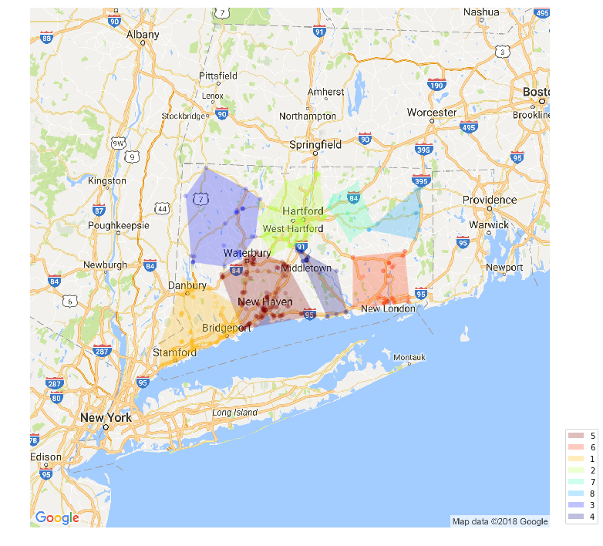
Drug-induced mortality rates and barriers to medical treatment

Slide 13
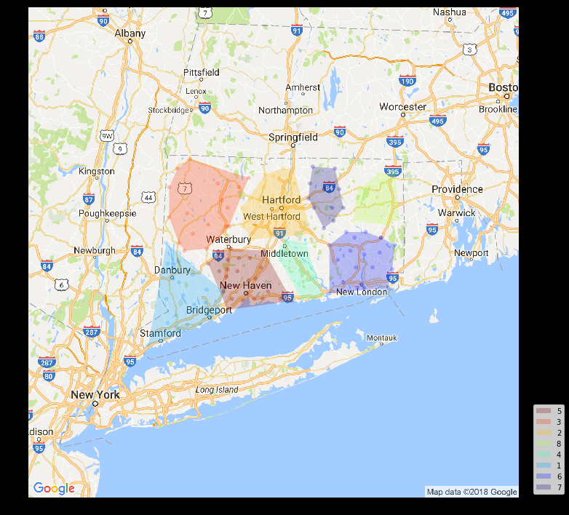
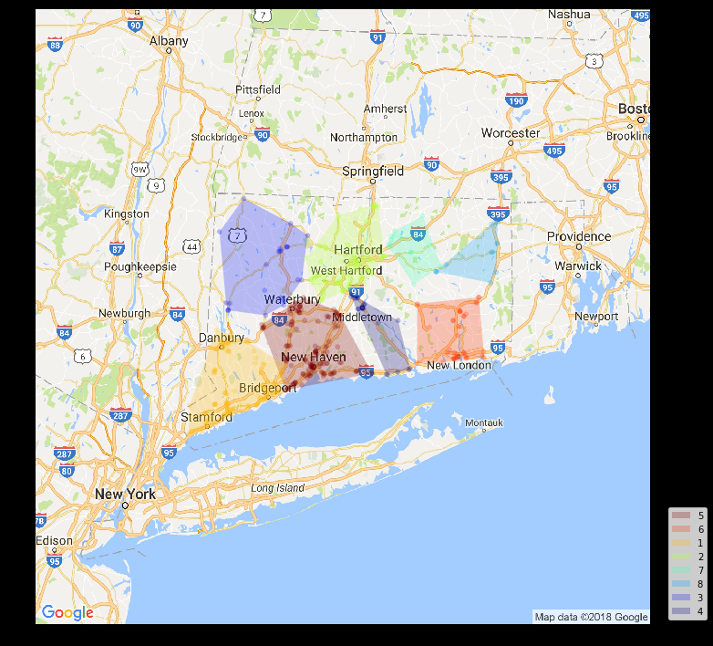
Relationship between deaths (due to opioids overdose) and Naloxone prescribing pharmacies in Connecticut (Deaths (Right) & Pharmacies (Left)

Slide 14
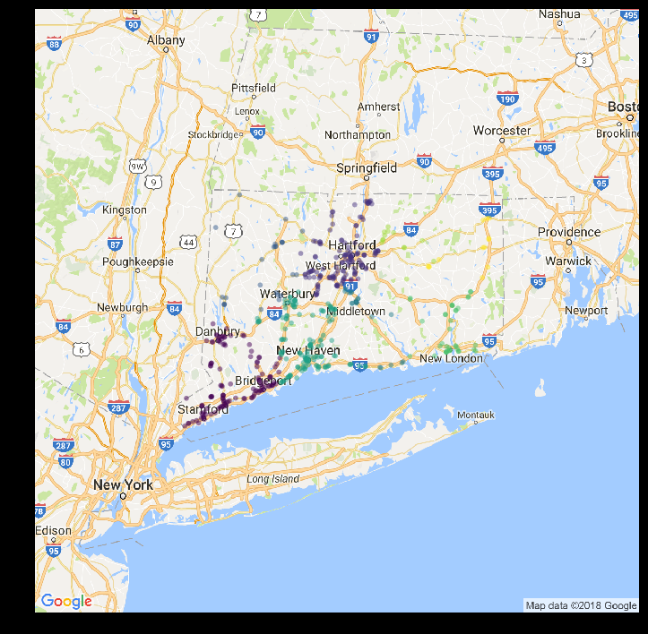
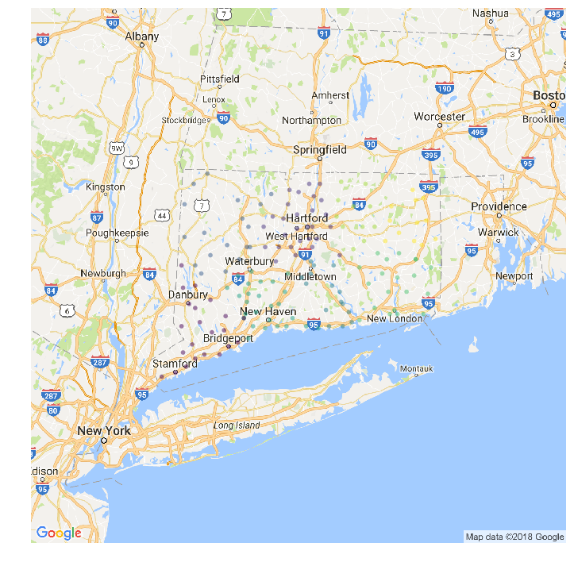
Relationship between Opioids related deaths and Naloxone prescribing pharmacies in Connecticut. (Deaths (Right) & Pharmacies (Left)

Slide 15
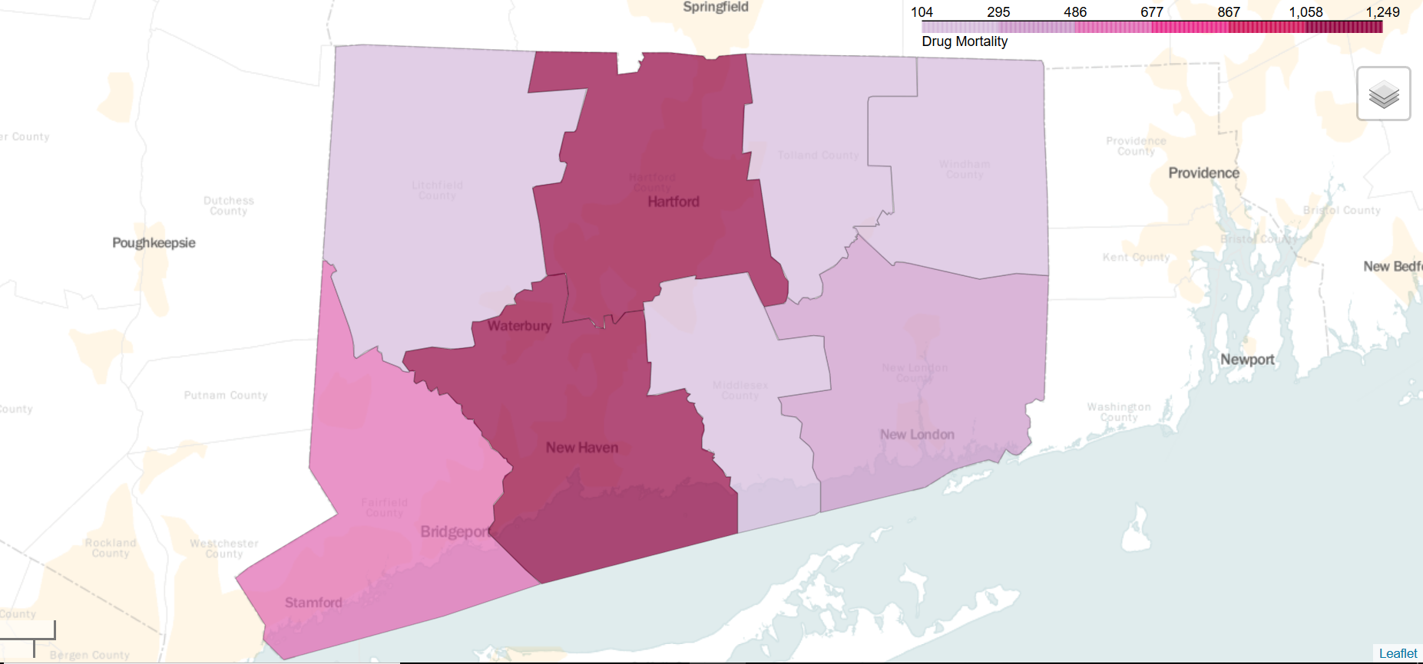
Drug-Induced Total Mortality by County

Slide 16
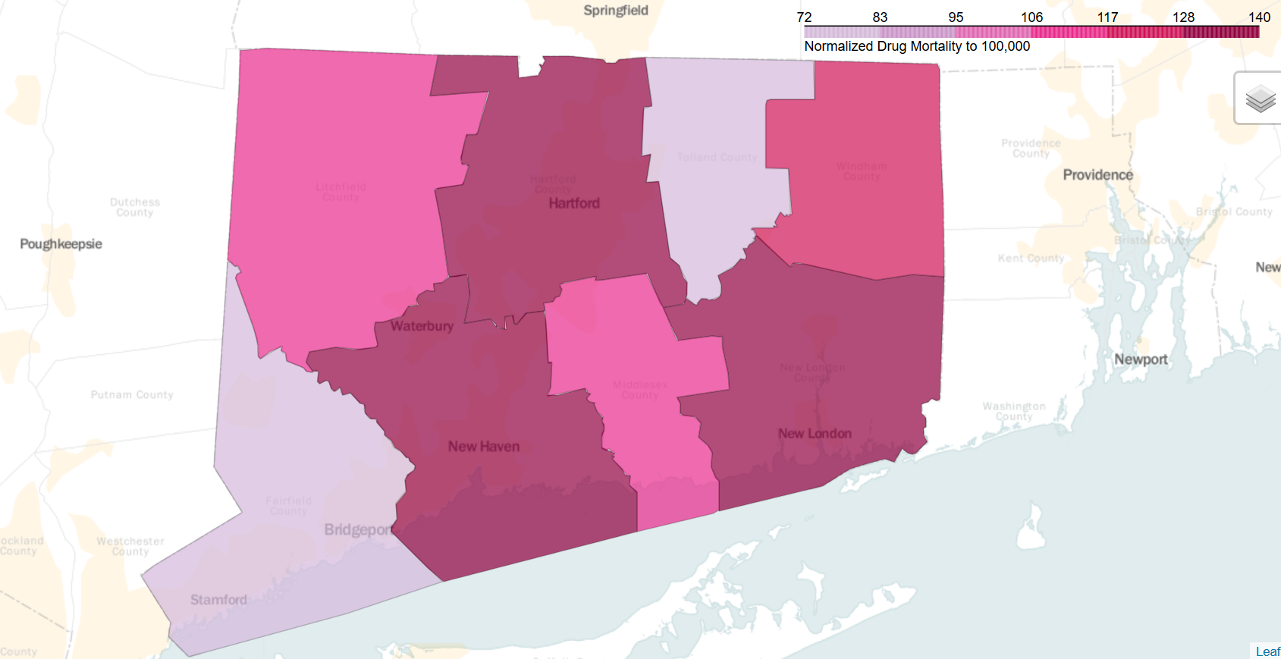
Drug-Induced Mortality by County per 100K

Slide 17
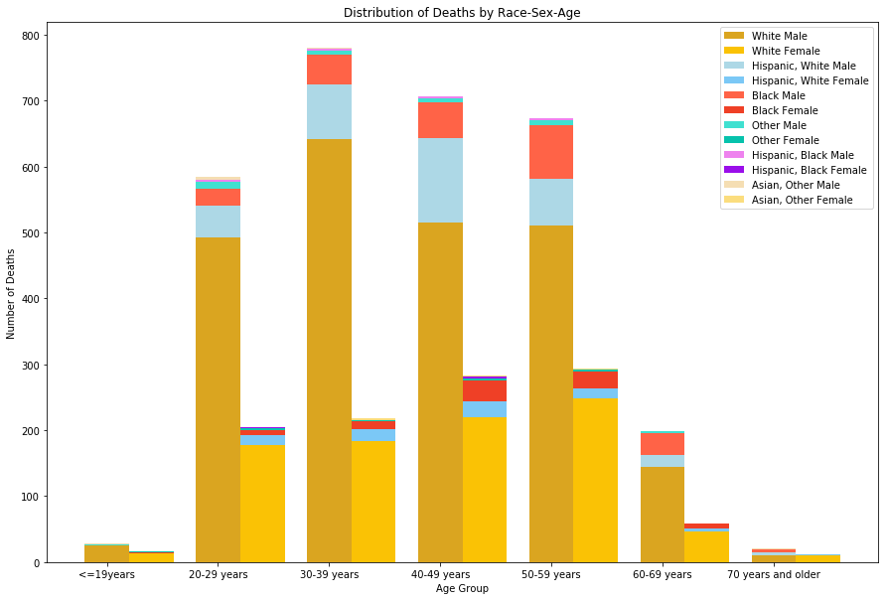
Drug-Induced Mortality by Gender, Race, and Sex

Slide 18
Drug-Induced Mortality by Gender, Race, and Sex
Age Group | Population % | Expected | Observed
20-29 years | 19.88 | 584.8696 | 584
30-39 years | 18.61 | 547.5062 | 780
40-49 years | 23.98 | 705.4916 | 706
50-59 years | 22.71 | 668.1282 | 673
60-69 years | 14.82 | 436.0044 | 199
Total | 100 | 2942 | 2942
Chi-Squared Test p-value: |  | 4.34786E-48
Race | Population % | Expected | Observed
White | 71.2 | 2904.248 | 3242
Hispanic White | 6.3 | 256.977 | 432
Black | 9.4 | 383.426 | 329
Hispanic Black | 0.8 | 32.632 | 17
Asian | 3.8 | 155.002 | 14
Other | 8.5 | 346.715 | 45
 | 100 | 4079 | 4079
Chi-Squared Test p-value: |  | 9.3448E-120
Chi-Squared test on both cases gives a p-value of almost 0, rejecting null hypothesis. (Some groups are affected more than others).

Slide 19
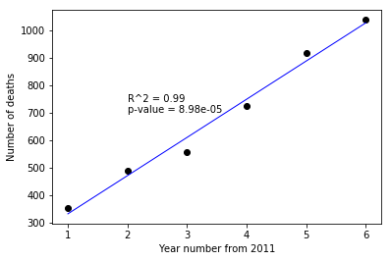
Drug-induced Mortality by Year
Fitting linear regression:
Independent variable: Year number
Dependent variable : Number of deaths in that year
Intercept = 193.33, Slope = 139
Prediction for 2018 = 1166 deaths

Slide 20
Conclusions
Drug related mortality is expected to go up year-over-year.
Fentanyl is fueling the increase.
Some groups (Males; White and Hispanic White; 30-39 age group) are affected disproportionately.

Slide 21
Questions?

